Slide 1
Application Delivery Fundamentals 2.0 B: Java
Rest Services Jersey, Apache CXF and Apache Play Framework

Slide 2
Objectives
At the end of this presentation, the participant will be able to:
Understand the basics of the HTTP protocol.
Understand how REST web services fit onto the HTTP protocol.
Understand how the JAX-RS APIs and annotations can be used to develop REST web services.
Understand how CXF can be configured with Spring to produce JAX-RS web services in a web application.
Understand how JAX-RS differs and compares to Spring MVC
Understand how to negotiate content in a JAX-RS service.
Understand how to handle responses and exceptions in a JAX-RS service.

Slide 3
Objectives
1. Getting Started
Jersey Rest Hello World Example
2. JAX-RS Application, Resources, and Sub-Resources
Guide to Core JAX-RS Concepts
3. JAX-RS Annotations
Guide to Standard JAX-RS Annotations
JAX-RS Parameter Annotations
JAX-RS @Context Annotation with Examples
4. Client API
Overview of Jersey JAX-RS Client API
Jersey JAX-RS Client for CRUD Restful Web Services
Jersey JAX-RS Client API Examples

Slide 4
Objectives
5. Logging
Jersey Rest Logging using LoggingFeature
Guide to Jersey logging on Server and Client side
6. Spring DI
Jersey Spring Integration CRUD Example
7. Jersey Test Framework
Guide to Jersey Test Framework Basics
How to test Jersey Rest API with JUnit
8. Jersey Rest Examples
Jersey JAX-RS Restful CRUD Web Services Example
JAX RS Filters and Interceptors

Slide 5
Objectives
9. Rest API Design Best Practices
Restful API Design Best Practices
10. REST Basics
Overview of REST
REST Architectural Constraints
REST Architectural Properties
REST Architectural Elements

Slide 6
Introduction to REST
REST (Representational State Transfer) is an architectural style used for designing networked applications.
It leverages standard web protocols, primarily HTTP, to enable communication between clients and servers in a stateless, scalable, and resource-focused manner.

Slide 7
Introduction to REST
Representational
Clients possess the information necessary to identify, modify, and/or delete a web resource.
State
All resource state information is stored on the client.
Transfer
Client state is passed from the client to the service through HTTP.

Slide 8
Introduction to REST
The six characteristics of REST:
Uniform interface
Decoupled client-server interaction
Stateless
Cacheable
Layered
Extensible through code on demand (optional)
* Services that do not conform to the above required contstraints are not strictly RESTful web services.
Notes:
Paraphrased from Wikipedia:
The REST architectural style describes six constraints applied to the architecture:
Uniform interface
This is the API of the web service, describing operations and data structures.
It simplifies and decouples the architecture of both client and server, enabling each to evolve independently.
Client–server decoupling
Clients are separated from servers by a uniform interface.
For portability, clients must not concern themselves with data storage.
For simplicity and scalability, servers must not concern themselves with the UI or user state.
Servers and clients may be replaced and developed independently, as long as the interface is not altered.
Stateless
No client context should be store on the server between requests.
Each request contains all of the information necessary to service the request and session state is held in the client.
The server can be stateful, but server-side state must be addressable by URL as a resource.
This makes servers:
More scalable.
More visible for monitoring.
More reliable in the event of partial network failures
Cacheable
Clients may cache responses, so responses must define whether they are cachable to prevent clients reusing stale or inappropriate data in response to further requests.
Well-managed caching can eliminate repetitive client–server interactions, further improving scalability and performance.
Layered system
A client’s connection to a server may pass directly to the service or through several intermediaries, allowing:
Scalability by enabling load balancing and by providing shared caches
The enforcement of security policies.
Code on demand (optional)
Servers may temporarily extend or customize the functionality of a client by transferring logic to be executed. (e.g. client-side JavaScript)
If a service violates any constraint other than “code on demand”, it cannot strictly be referred to as REST web service. Complying with these constraints, and thus conforming to the REST architectural style, will improvie a service’s
Performance
Scalability
Simplicity
Modifiability
Visibility
Portability
Reliability

Slide 9
Key Concepts of REST
Resources
Everything in REST is considered a resource (e.g., users, products, orders).
Each resource is identified by a unique URI (Uniform Resource Identifier).
Example: https://api.example.com/users/123 represents a user with ID 123.

Slide 10
Key Concepts of REST
HTTP Methods REST services use standard HTTP methods to interact with resources:
GET: Retrieve a resource.
POST: Create a new resource.
PUT: Update an existing resource (or create if it doesn't exist).
DELETE: Remove a resource.
PATCH: Partially update a resource.

Slide 11
Key Concepts of REST
Stateless Communication
REST is stateless, meaning each request from the client to the server must contain all the information needed to process the request. The server does not store any client state between requests.

Slide 12
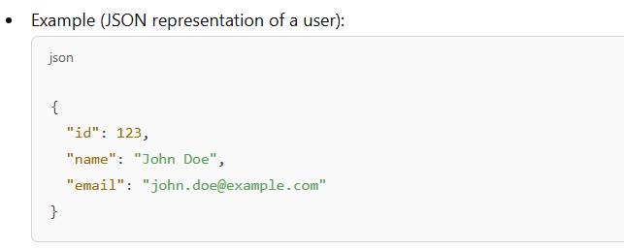
Key Concepts of REST
Representation
Resources are represented in formats such as:
JSON (JavaScript Object Notation) (most common)
XML (Extensible Markup Language)
Others like HTML or plain text.

Slide 13
Key Concepts of REST
Client-Server Separation
REST enforces a clear separation between the client and the server, allowing each to evolve independently.
Statelessness
Each request must contain all necessary information.
For example, authentication details (like API keys or tokens) must be included in each request.
Caching
Responses can be cached to improve performance and reduce server load.
HTTP caching headers (e.g., Cache-Control, ETag) are commonly used.

Slide 14
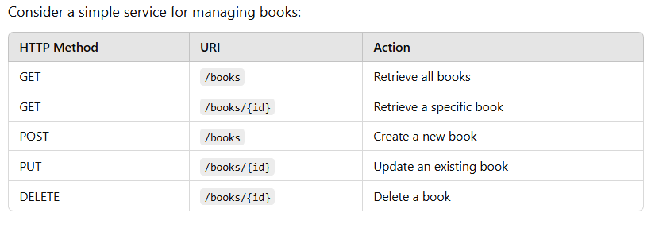
Examples of REST

Slide 15
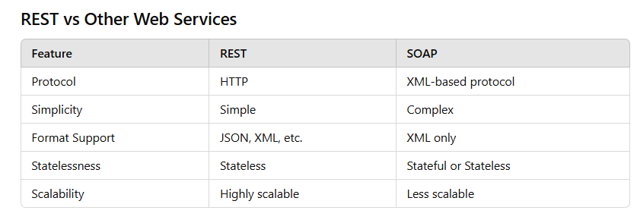
Examples of REST

Slide 16
Benefits of REST
Simplicity: Easy to understand and implement.
Scalability: Statelessness allows load balancing and distributed systems.
Flexibility: Supports multiple data formats.
Interoperability: Widely adopted standards ensure compatibility.

Slide 17
HTTP-REST Request Basics
The HTTP request is sent from the client.
Identifies the location of a resource.
Specifies the verb, or HTTP method to use when accessing the resource.
Supplies optional request headers (name-value pairs) that provide additional information the server may need when processing the request.
Supplies an optional request body that identifies additional data to be uploaded to the server (e.g. form parameters, attachments, etc.)
Notes:
Resource – identified by a URL (or uniform resource locator)
Method – the action verb to perform on a resource
e.g. GET, POST, PUT, DELETE, etc.
Request Headers – name-value pairs of meta-information about the request
e.g. Content types expected by the client
Request Body – data to be streamed from the client to the server
e.g. Attachments, form parameters, etc.

Slide 18
HTTP-REST Request Basics
Sample Client Requests:
A typical client GET request:
A typical client POST request:
GET /view?id=1 HTTP/1.1
User-Agent: Chrome
Accept: application/json
[CRLF]
Requested Resource (path and query string)
Request Headers
(no request body)
POST /save HTTP/1.1
User-Agent: IE
Content-Type: application/x-www-form-urlencoded
[CRLF]
name=x&id=2
Requested Resource (typically no query string)
Request Headers
Request Body (e.g. form parameters)
Notes:
Note: A REST web service may return the representation of a resource in many formats (HTML, XML, JSON, binary).
It is the client’s responsibility to use the “Accept” request header to identify the expected content type of the returned resource.

Slide 19
HTTP-REST Response Basics
The HTTP response is sent from the server.
Gives the status of the processed request.
Supplies response headers (name-value pairs) that provide additional information about the response.
Supplies an optional response body that identifies additional data to be downloaded to the client (html, xml, binary data, etc.)
Notes:
Status – An HTTP status code and status message
e.g. 404 Not Found, 200 OK
Response Headers – name-value pairs of meta-information about the response
e.g. Content-Type
Response Body – Additional data to be streamed from the server to the client
e.g. HTML document, XML document, binary data

Slide 20
HTTP-REST Response Basics
Sample Server Responses:
HTTP/1.1 200 OK
Content-Type: text/html
Content-Length: 1337
[CRLF]
<html>
<!-- Some HTML Content. -->
</html>
Response Status
Response Headers
Response Body (content)
HTTP/1.1 500 Internal Server Error
Response Status
HTTP/1.1 201 Created
Location: /view/7
[CRLF]
Some message goes here.
Response Status
Response Header
Response Body

Slide 21
HTTP-REST Vocabulary
HTTP Methods supported by REST:
GET – Requests a resource at the request URL
Should not contain a request body, as it will be discarded.
May be cached locally or on the server.
May produce a resource, but should not modify on it.
POST – Submits information to the service for processing
Should typically return the new or modified resource.
PUT – Add a new resource at the request URL
DELETE – Removes the resource at the request URL
OPTIONS – Indicates which methods are supported
HEAD – Returns meta information about the request URL
Notes:
HTTP Methods:
GET – The same request URL should return the same resource every time. The request URL should represent a web resource.
POST – A generic method for submitting information to the service. The outcome is defined by the service. The request URL need not represent a web resource.
PUT – Adds a new resource at the request URL. The resource should then be available through a GET request using the same request URL.
DELETE – Removes the resource at the request URL. The resource should no longer be available via a GET request at that URL.
OPTIONS – Indicates which HTTP methods are supported at the request URL. Useful for identifying
HEAD – Same as GET but only returns meta-information about the resource. The response body will be empty. Useful for requesting information about a resource without having to request the resource itself.
Other HTTP verbs are NOT typically supported in a REST service.
The above guidelines are required if you wish to remain compliant with the HTTP specification
Actual usage of HTTP verbs may vary from implementation to implementation.
When producing a service for consumption by a third-party, it is recommended that the service adhere to the HTTP specification
Difference between POST and PUT:
“The fundamental difference between the POST and PUT requests is reflected in the different meaning of the Request-URI. The URI in a POST request identifies the resource that will handle the enclosed entity. That resource might be a data-accepting process, a gateway to some other protocol, or a separate entity that accepts annotations. In contrast, the URI in a PUT request identifies the entity enclosed with the request -- the user agent knows what URI is intended and the server MUST NOT attempt to apply the request to some other resource. If the server desires that the request be applied to a different URI, it MUST send a 301 (Moved Permanently) response; the user agent MAY then make its own decision regarding whether or not to redirect the request.” – Emphasis added, W3C HTTP Method specification, referenced at end of presentation
Methods Naving No Request Body:
GET, DELETE, OPTIONS, HEAD
Methods Having a Request Body:
POST – body may contain form parameters or other information to be uploaded to the service
PUT – body contains the resource to be represented at the request URL
Methods Supplying No Response Body
HEAD
OPTIONS

Slide 22
HTTP-REST Vocabulary
A typical HTTP REST URL:
The protocol identifies the transport scheme that will be used to process and respond to the request.
The host name identifies the server address of the resource.
The path and query string can be used to identify and customize the accessed resource.
http://my.store.com/fruits/list?category=fruit&limit=20
protocol
host name
path to a resource
query string

Slide 23
HTTP and REST
A REST service framework provides a controller for routing HTTP requests to a request handler according to:
The HTTP method used (e.g. GET, POST)
Supplied path information (e.g /service/listItems)
Query, form, and path parameters
Headers, cookies, etc.

Slide 24
Producing REST Services
REST services in Java web applications can be implemented in several ways:
As a plain Java Servlet
Adequate for very simple REST services.
Requires a lot of “boiler plate” code for complex services.
Using a REST service framework.
Eliminates the need to write “boilerplate” code.
Typically integrates with other technologies, such as Spring.
Java provides the JAX-RS specification for use by providers of REST service frameworks.

Slide 25
Introduction to SOAP Services
SOAP (Simple Object Access Protocol) is a protocol for exchanging structured information in a distributed environment, often over HTTP or SMTP.
It is used to build web services that are platform- and language-independent, enabling different applications to communicate seamlessly.

Slide 26
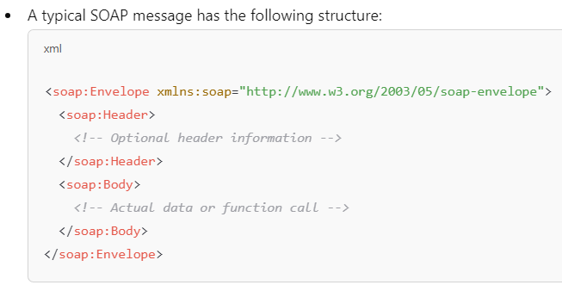
Key Concepts of SOAP
Protocol-Based
SOAP is a protocol, not an architectural style like REST. It has strict rules about message formats and processing.
Message Format
SOAP messages are always formatted in XML.

Slide 27
Key Concepts of SOAP
WSDL (Web Services Description Language)
SOAP services use WSDL to describe their interface and operations. It acts as a contract that specifies:
Available methods
Input and output data formats
Endpoints

Slide 28
Key Concepts of SOAP
Transport Protocols
Commonly uses HTTP/HTTPS but can also use SMTP, TCP, or other protocols.
Security
Provides robust security features using WS-Security, which supports encryption, digital signatures, and tokens.

Slide 29
Key Components of SOAP
SOAP Envelope
Defines the message structure and namespaces.
Contains the header and body.
SOAP Header
Optional metadata about the message, such as authentication, transaction information, or routing data.
SOAP Body
Contains the actual message or data to be processed.
Fault Element
Used for error handling. If something goes wrong, a Fault element is returned in the SOAP message.

Slide 30
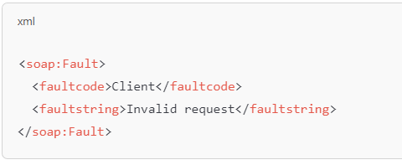
Key Components of SOAP

Slide 31
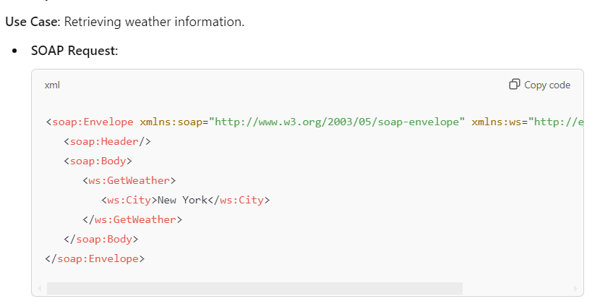
Example of a SOAP Service

Slide 32
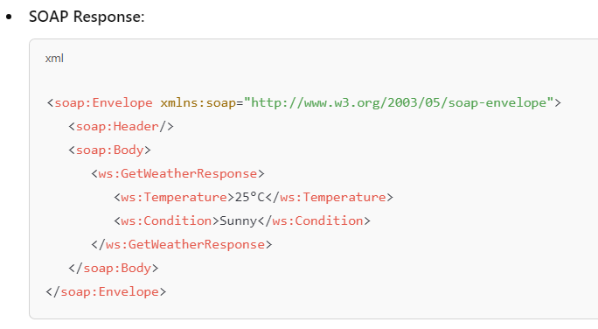
Example of a SOAP Service

Slide 33
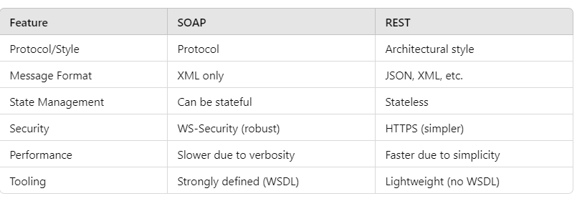
SOAP vs REST

Slide 34
Advantages of SOAP
Platform Independence: Works across platforms and languages.
Standardized: Strict protocol ensures consistency.
Strong Security: Supports advanced security protocols.
Error Handling: Built-in error reporting with the Fault element.
Asynchronous Processing: Can work over SMTP and other asynchronous protocol

Slide 35
Disadvantages of SOAP
Complexity: More complex than REST.
Performance Overhead: XML verbosity leads to larger message sizes and slower processing.
Less Flexibility: Limited to XML and fixed protocol rules.
Difficult Debugging: Parsing and understanding XML can be challenging.

Slide 36
REST on the Java Stack
Although developers may implement REST web services however they choose, the Java Stack team is best equipped to support the following:
Jersey
Apache CXF
A JAX-RS web service framework
Apache Play Framework
Spring MVC
An MVC framework built upon the Spring Platform (does not implement the JAX-RS specification)

Slide 37
REST Services with JAX-RS
JAX-RS is a Java standard API for REST services:
Services are annotation driven
Provides support for data binding.
Provides advanced APIs for content negotiation.
CXF provides an implementation of JAX-RS:
Supports CXF filters, interceptors, and invokers to customize and extend the service.
Configurable through Spring.
Integrates with security providers.

Slide 38
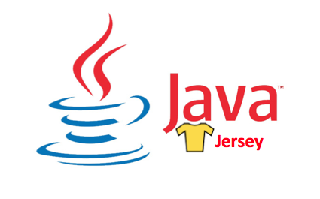
Jersey Framework
Java Jersey project tracks the JAX-RS API, which is used to create Restful web services in Java.

Slide 39
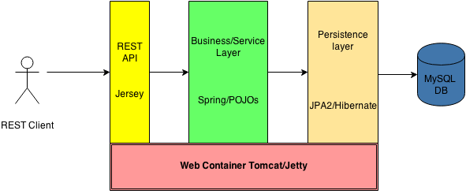
Jersey Framework

Slide 40
Jersey Framework
Java API for RESTful Web Services (JAX-RS), is a set if APIs to developer REST service. JAX-RS is part of the Java EE6, and make developers to develop REST web application easily.
Jersey is the open source, production quality, JAX-RS (JSR 311) Reference Implementation for building RESTful Web services.
But, it is also more than the Reference Implementation. Jersey provides an API so that developers may extend Jersey to suit their needs

Slide 41
Components of Jersey
Jersey has four components.
Core Server:- It is used for building RESTful web services. The components consist of jersey-core, jersey-server and jsr311-api.
Core Client:- For interaction with web services we need a client to communicate between web services. The components consist of jersey-client.
JAXB support:- Jersey provides support for JAXB. It makes XML to object conversion easy. The component which performs this support is jersey-server.
JSON support:- Jersey provides support for JAXB. It makes JSON to object conversion easy. The component which performs this support is jersey-server.
Easy integration with Spring and Guice framework.

Slide 42
Tools and Technologies
Eclipse Oxygen.2 Release (4.7.2)
Java – version 9.0.4
Gradle – 4.6 /Maven 3.x
JAX-RS 2.1
Jersey-2.26
Tomcat 9.0

Slide 43
Development Steps
Create Maven Web Application Project
Project Packaging Structure
Update Jersey Dependencies in a Pom.Xml File
Create Resource - HelloWorldResource.java
Descriptor-Less Deployment Configuration
Build and Deployment

Slide 44
JAX-RS Annotations
JAX-RS Annotations customize many parts of the REST service:
They identify the HTTP method for accessing a resource.
They identify the relative path for accessing a resource.
They identify how query and form parameters, headers, cookies and other pieces of the HTTP request message map to Java parameters and fields.
They identify the available content types that can be consumed or produced for a resource.

Slide 45
JAX-RS Concepts
Root Resources
Useful JAX-RS annotations
Sub-resources
Sub-resource locators
HTTP methods

Slide 46
Root Resource
Root resource classes are POJOs (Plain Old Java Objects) that are annotated with @Path have at least one method annotated with @Path or a resource method designator annotation such as @GET, @PUT, @POST, @DELETE.
Resource methods are methods of a resource class annotated with a resource method designator (resource method designator annotation such as @GET, @PUT, @POST, @DELETE).

Slide 47
The @Path Annotation
The @Path annotation's value is a relative URI path.
In the example above, the Java class will be hosted at the URI path /helloworld.
This is an extremely simple use of the @Path annotation.
What makes JAX-RS so useful is that you can embed variables in the URIs.
URI path templates are URIs with variables embedded within the URI syntax.
These variables are substituted at runtime in order for a resource to respond to a request based on the substituted URI.
Variables are denoted by curly braces. For example, look at the following @Path annotation:

Slide 48
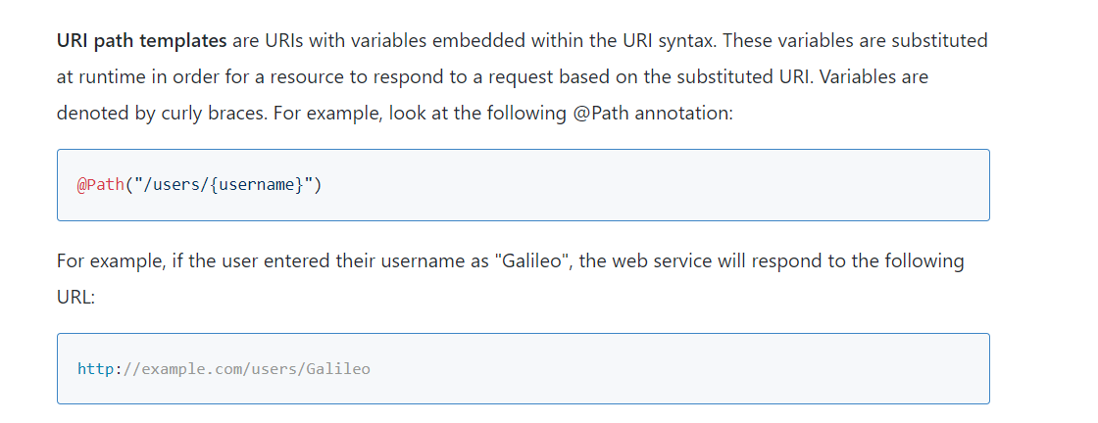
The @Path Annotation

Slide 49
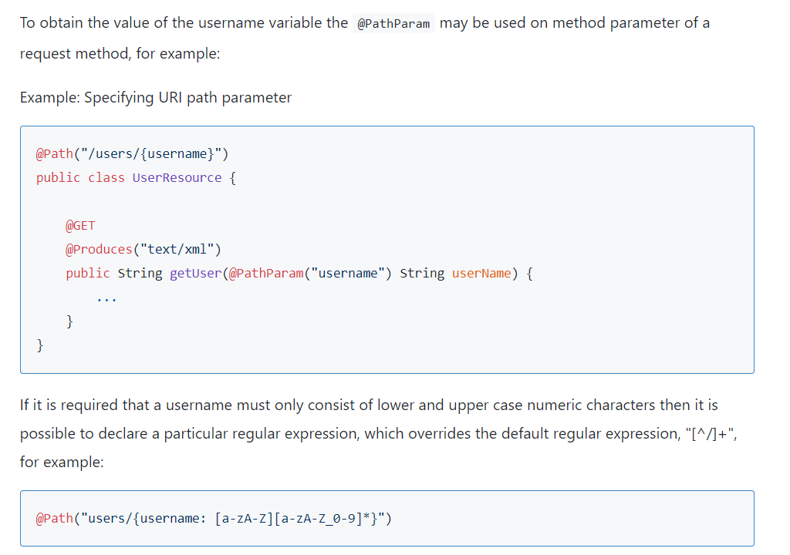
The @Path Annotation

Slide 50
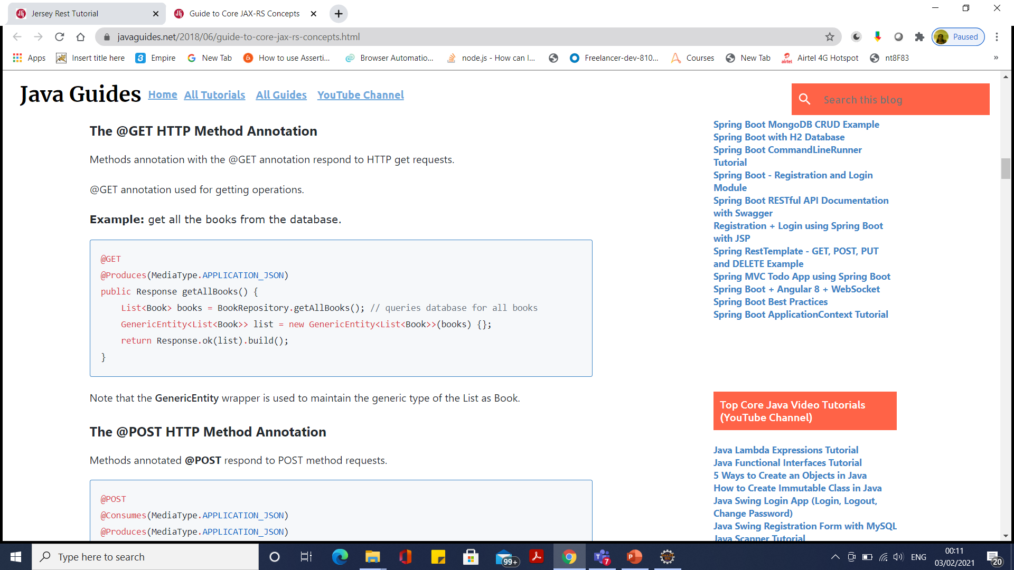
@GET

Slide 51
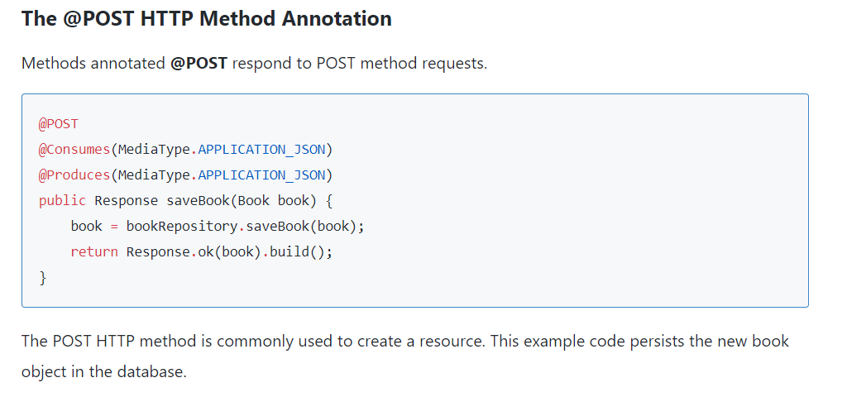
@POST

Slide 52
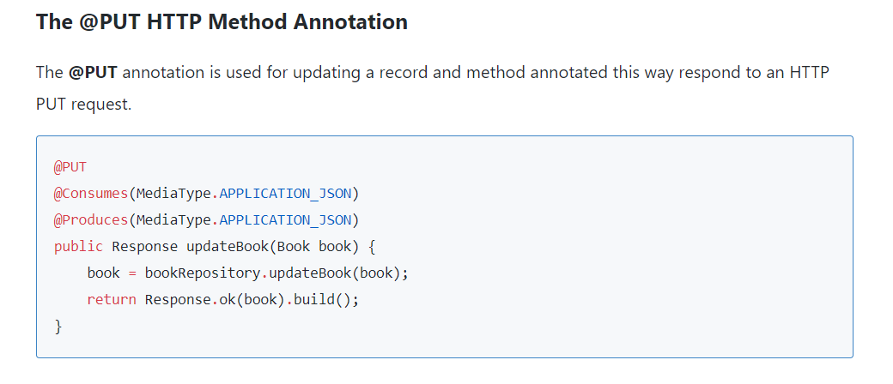
@PUT

Slide 53
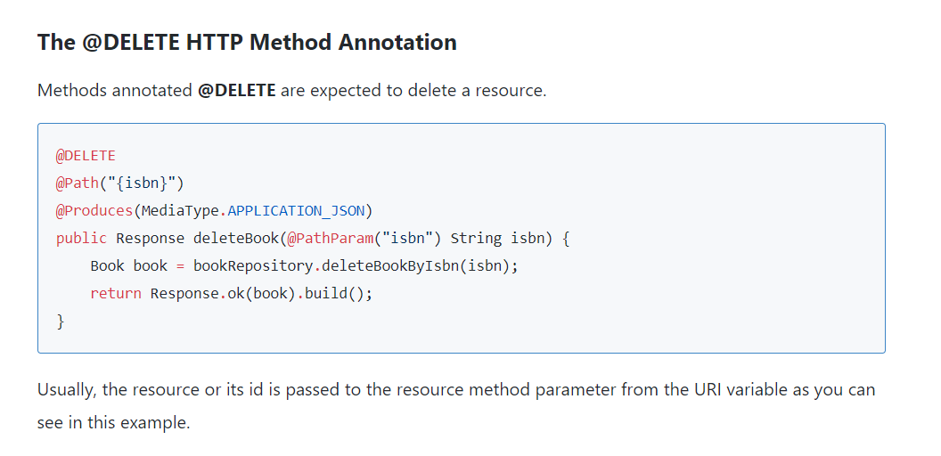
@Delete

Slide 54
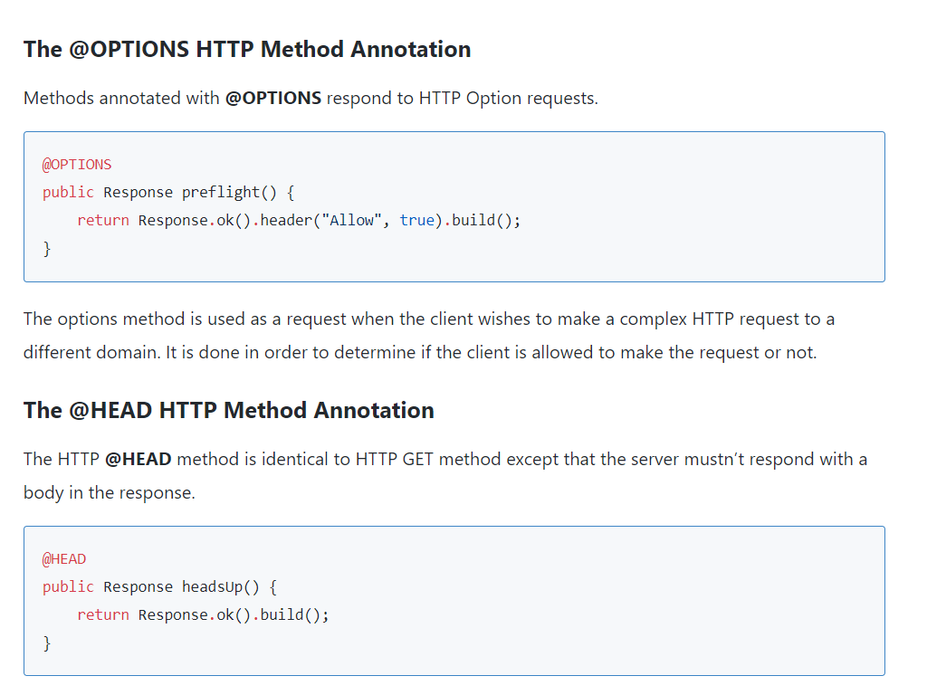
@Options

Slide 55
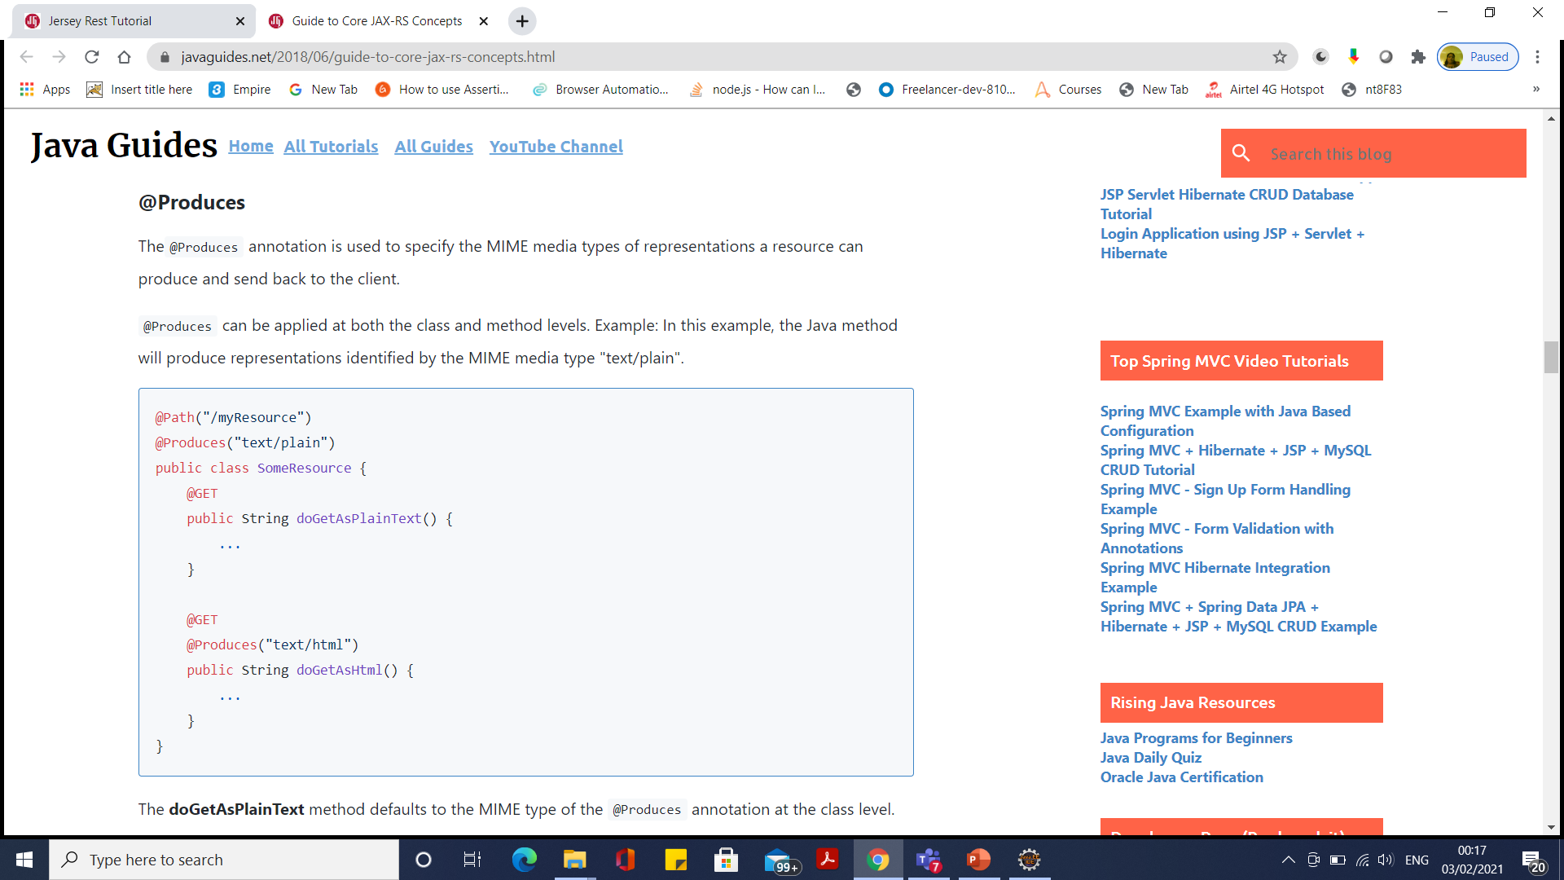
@Produces

Slide 56
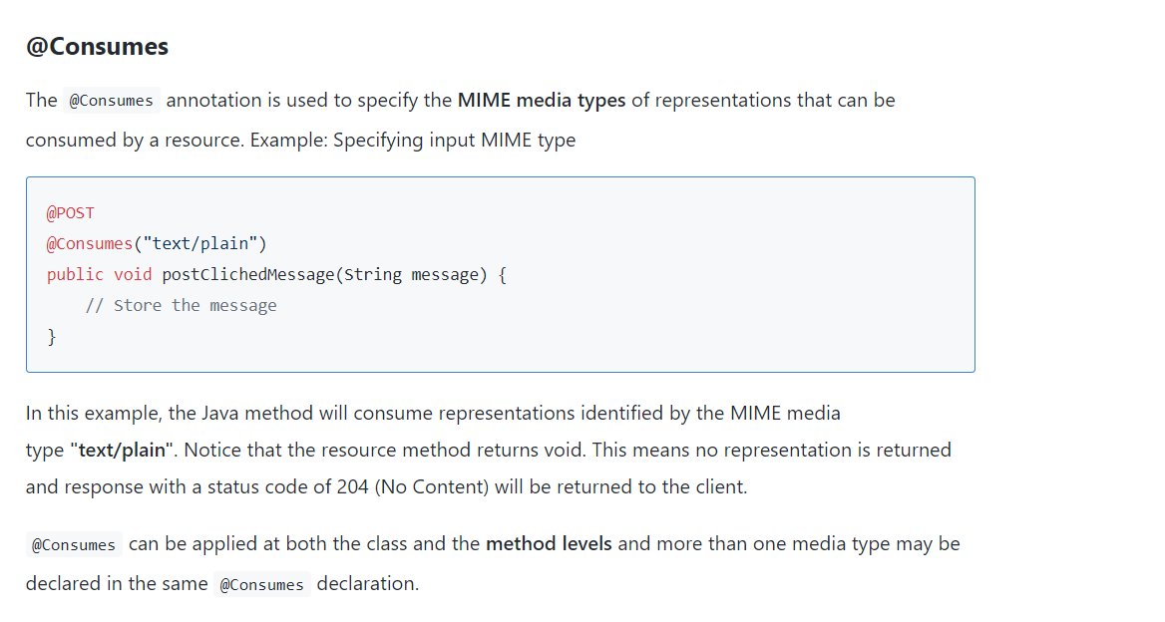
@Consumes

Slide 57
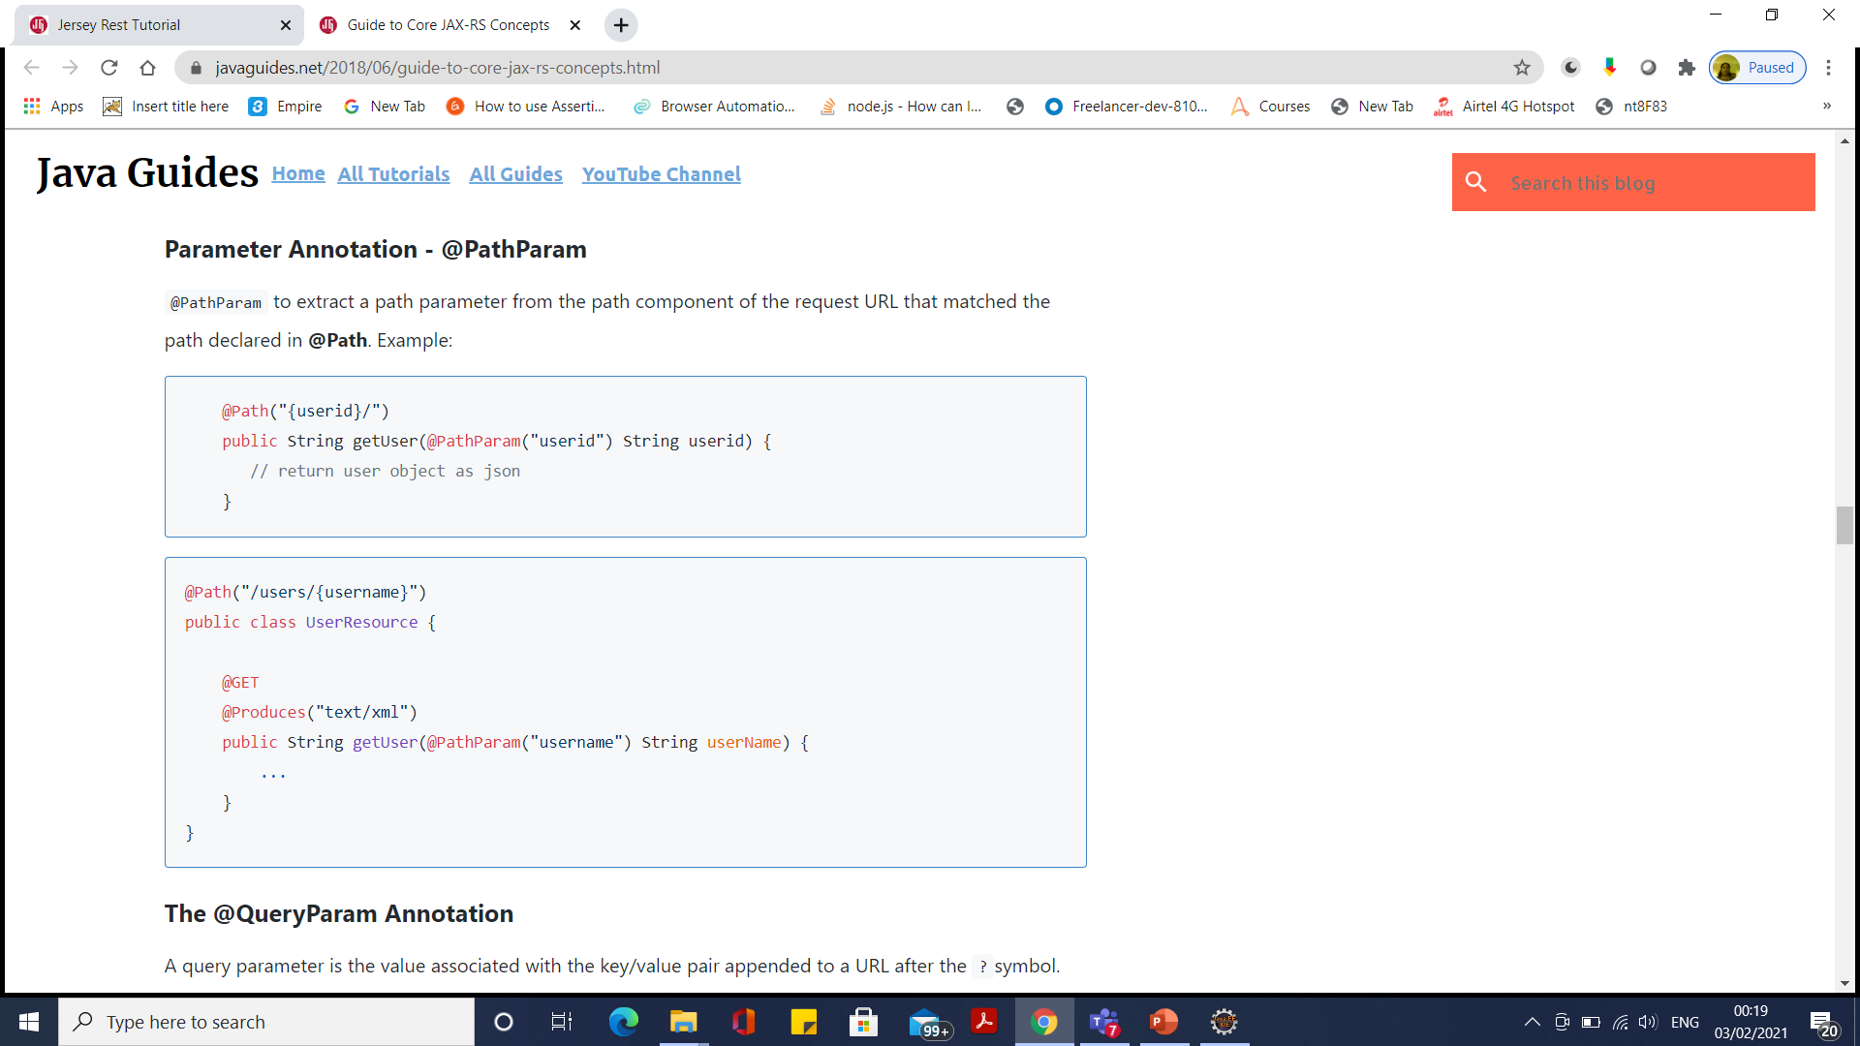
@PathParam

Slide 58
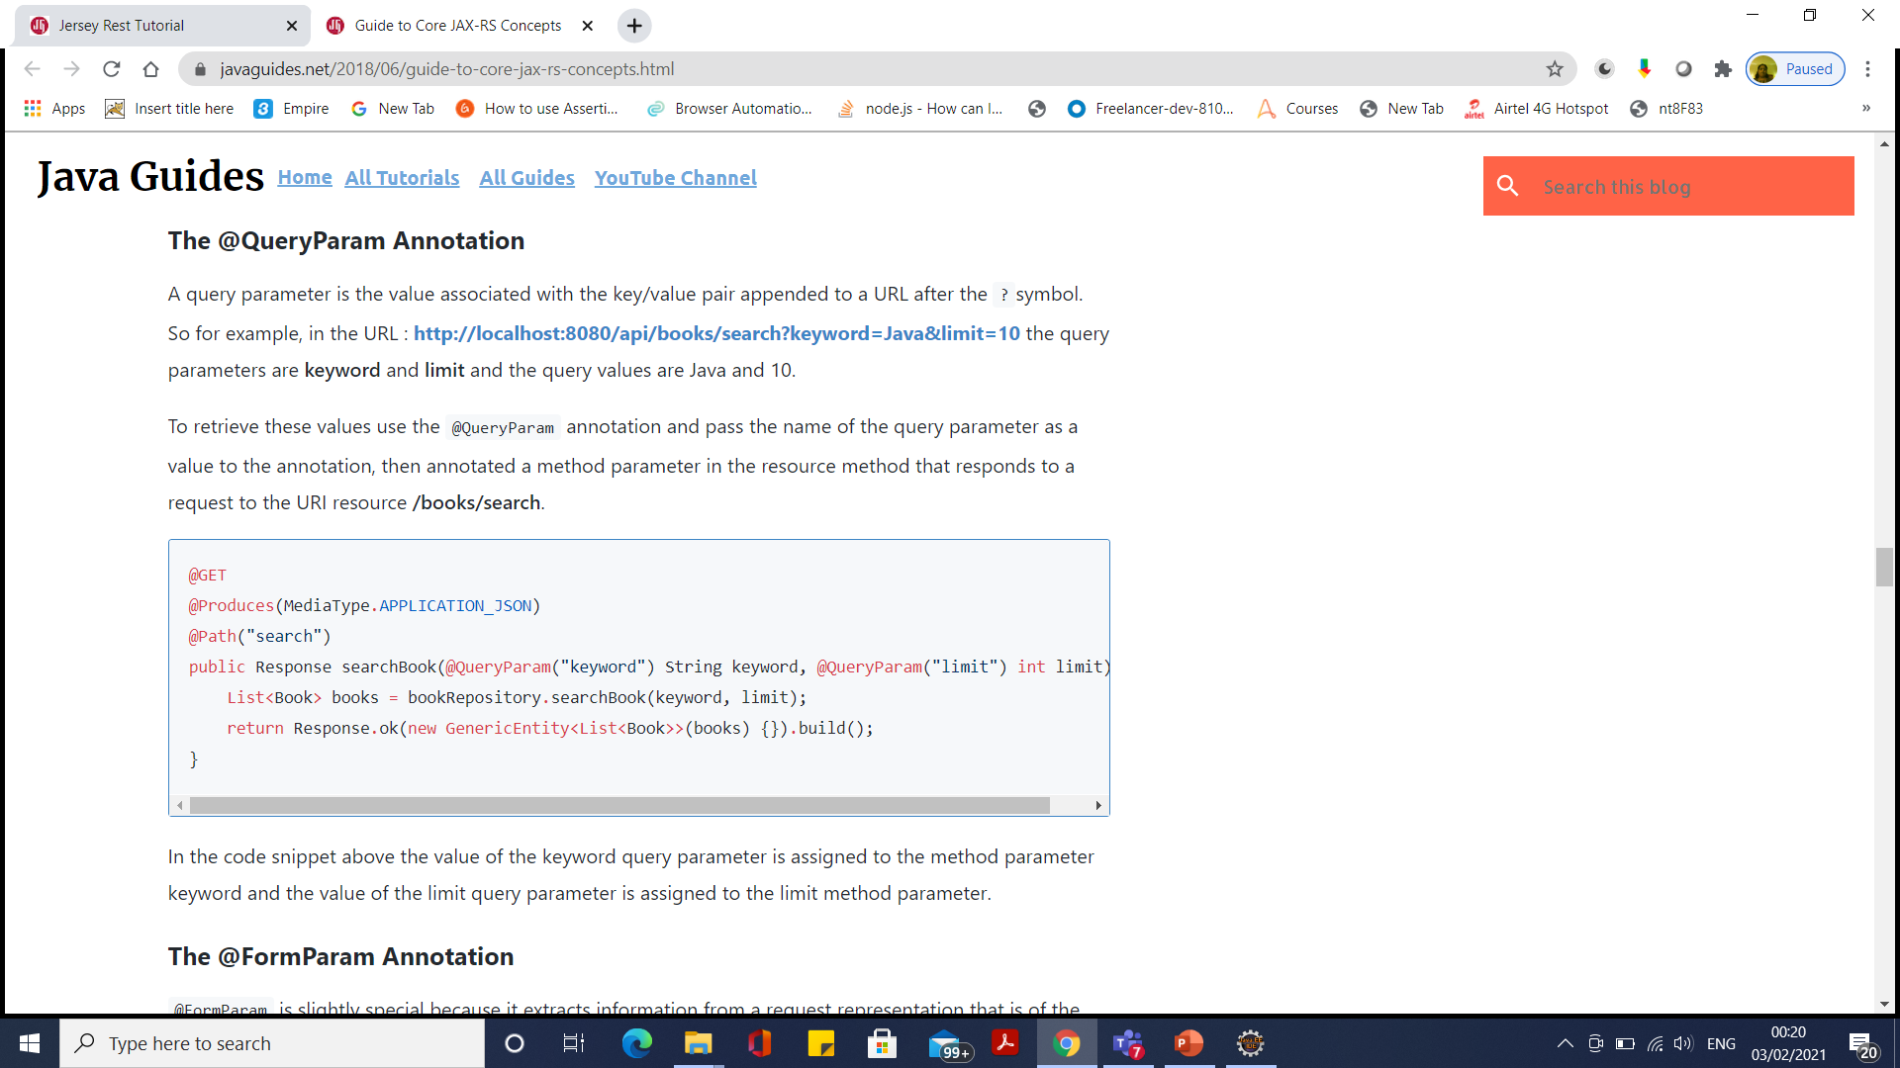
@QueryParam

Slide 59
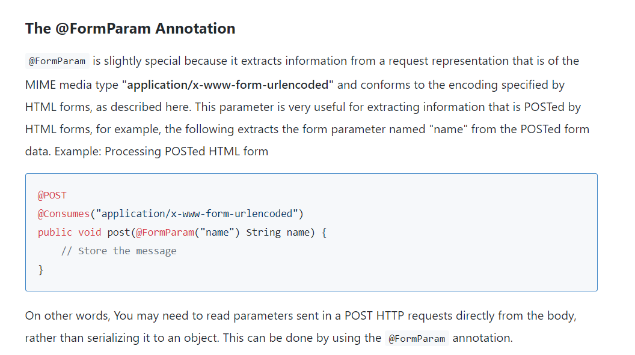
@FormParam

Slide 60
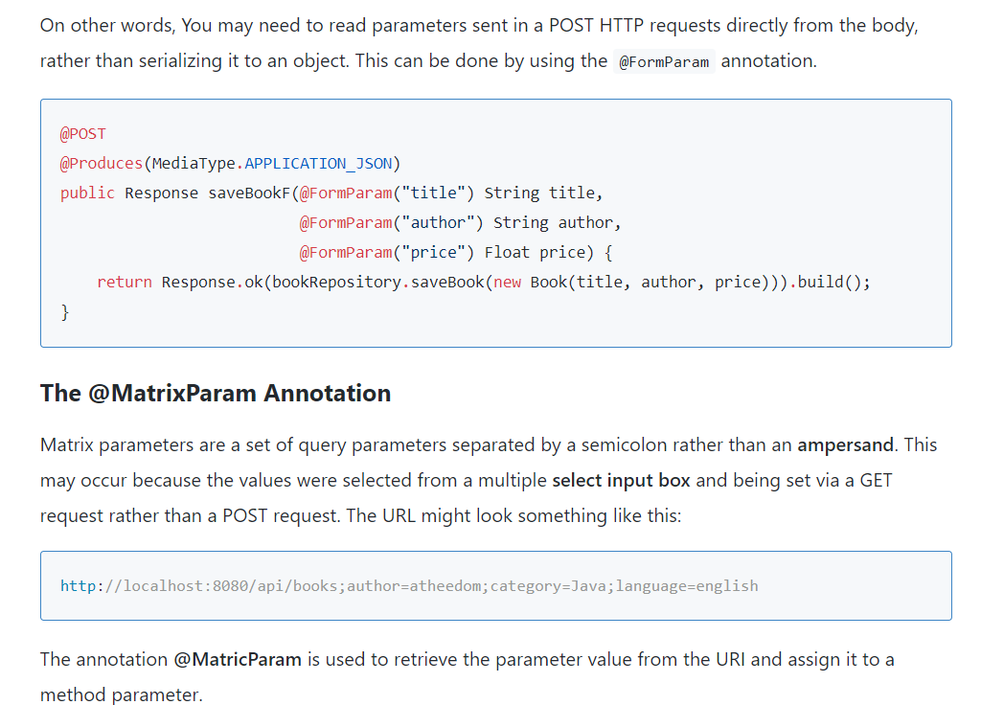
@Form Param and @Matrix Param

Slide 61
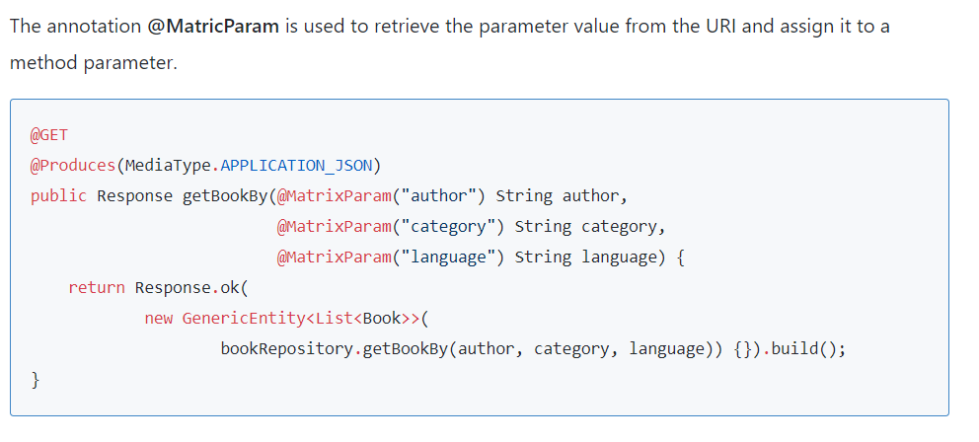
@Matrix Param

Slide 62
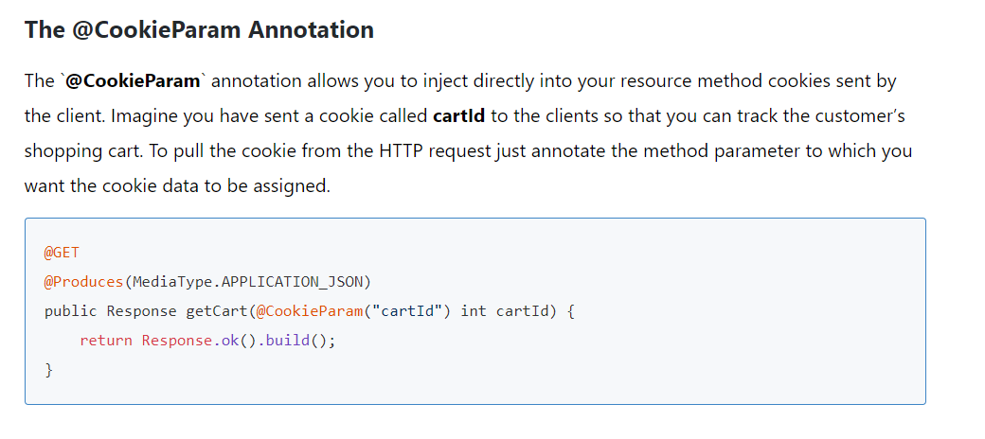
The @CookieParam Annotation

Slide 63
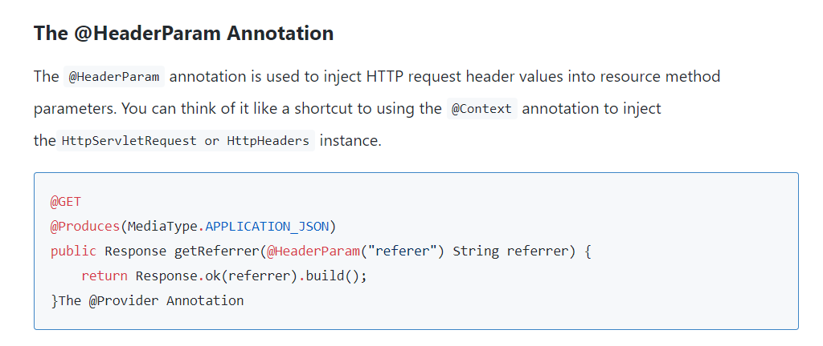
@Header Param

Slide 64
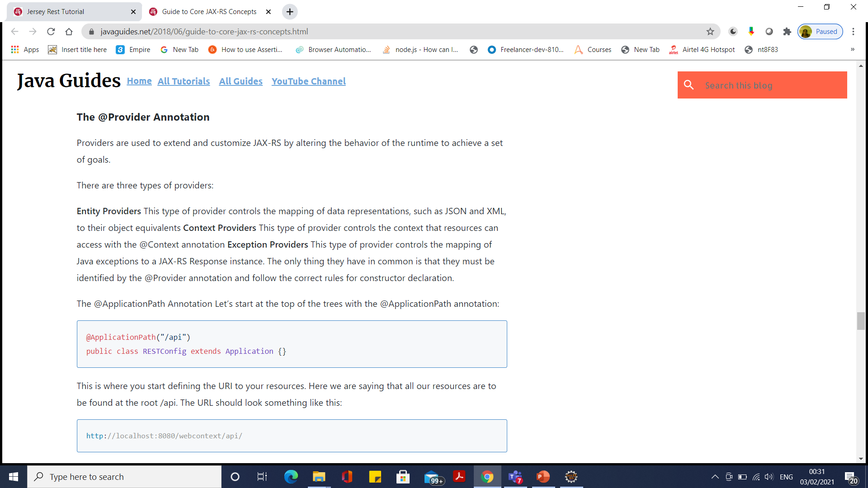
The @Provider Annotation

Slide 65
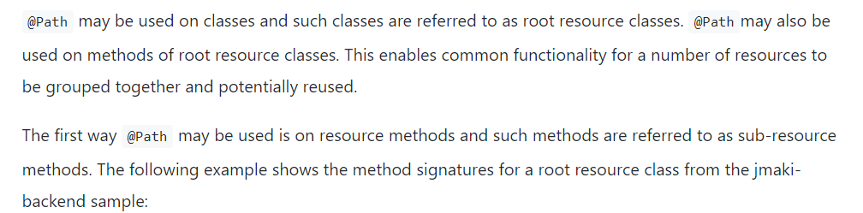
Sub resources

Slide 66
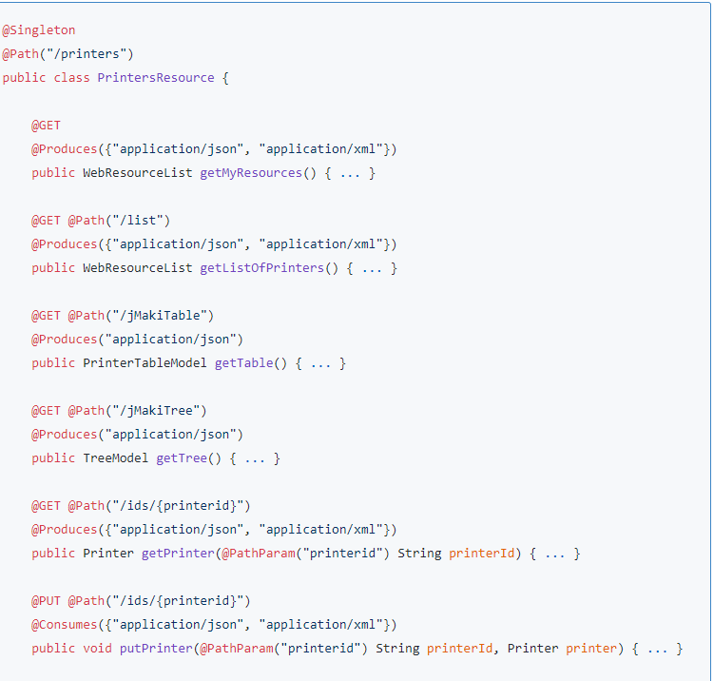
Sub resources

Slide 67
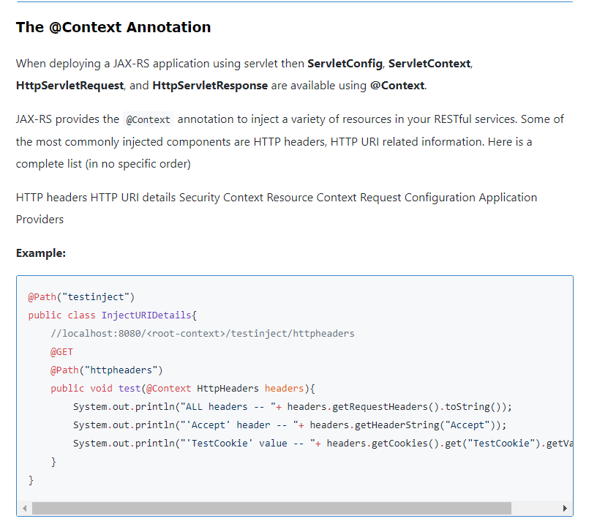
@Context Annotation

Slide 68
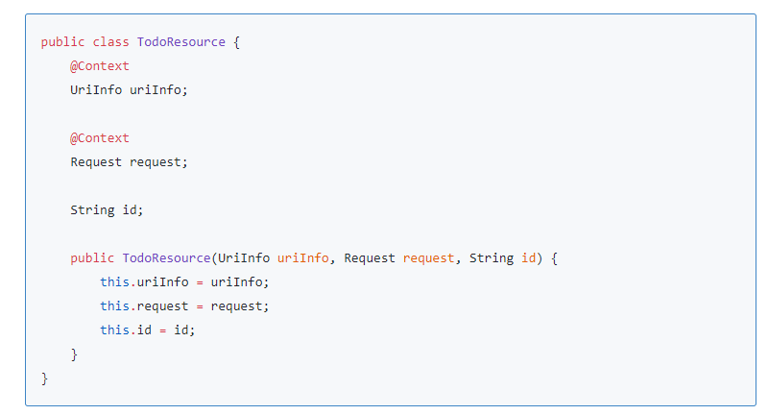
@Context Annotation

Slide 69
JAX-RS @Path Annotation
@Path annotations may be supplied to customize the request URI of resource.
@Path on a class defines the base relative path for all resources supplied by that class.
@Path on a Java class method defines the relative path for the resource bound to that method.
@Path on a method is relative to any @Path on the class.
In the absence of @Path on the class or method, the resource is defined to reside at the root of the service.
A leading forward slash (/) is unecessary as the path is always relative.

Slide 70
JAX-RS: @Path Annotation
The @Path annotation supports the use of template parameters in the form:
{ name : regex }
The template parameter name is required.
The colon (:) followed by a regular expression is optional and will default to the pattern: [^/]+
Multiple template parameters may be defined in a single @Path.
Template parameter values will be injected into method parameters annotated with @PathParam.

Slide 71
JAX-RS Parameter Annotations
Common JAX-RS Parameter Annotations:
@QueryParam – maps to a query string parameter.
@FormParam – maps to a form POST parameter.
@PathParam – maps to a path segment.
@DefaultValue – supplies a default parameter value.
Most often used on service methods to annotate input parameters.
Can also be used on fields or field setter methods if the service bean has request scope.
Additional parameter annotations are also available.
See the JAX-RS API documentation for details.

Slide 72
JAX-RS: MessageBodyWriter
To produce content in other formats (as output), do the following:
Implement javax.ws.rs.ext.MessageBodyWriter for the Java type that you want to write to the response.
Annotate the implementation with @Provider
Optionally annotate the implementation with @Produces to restrict the content types for which it is suitable.
Configure an instance of your provider as a Spring bean.
Supply a reference to your bean under the <stack-rs:providers> element of the <stack-rs:produce> configuration.

Slide 73
JAX-RS: Example PDF Export
@Provider
@Produces("application/pdf")
public class PdfWriter implements MessageBodyWriter<MyCatalog> {
public boolean isWriteable(Class<?> type, Type genericType,
Annotation[] annotations, MediaType mediaType) {
return true; // true means I can write the type to PDF
}
public long getSize(MyCatalog mc, Class<?> type, Type genericType,
Annotation[] annotations, MediaType mediaType) {
return -1; // Negative value means I don’t know yet
}
public void writeTo(MyCatalog mc, Class<?> type,
Type genericType, Annotation[] annot, MediaType mediaType,
MultivaluedMap<String, Object> httpHeaders,
OutputStream entityStream)
throws IOException, WebApplicationException {
// Use iText to generate PDF and write to entityStream
}
}
Notes:
In this example, we have stubbed out the implementation of a MessageBodyWriter that takes a MyCatalog object and writes a PDF representation of it to the response.
The @Provider annotation is required by JAX-RS.
The @Produces annotation is not required, but since our provider is specific to PDF output, we should use the @Produces annotation to indicate that fact.
The isWritable method should be implemented to ensure that we are being given a type that can be written with this provider
The getSize method can return the serialized size of the object (if it is known) or a negative value to indicate that it is not known (as would be the case here)
The bulk of the work is done by the writeTo method which would construct a PDF document using the iText library and then write it to the supplied output stream of the response.

Slide 74
JAX-RS: MessageBodyReader
To consume content in other formats (as input), do the following:
Implement javax.ws.rs.ext.MessageBodyReader for the type that you want to read from the request.
Annotate the implementation with @Provider
Optionally annotate the implementation with @Consumes to restrict the content types for which it is suitable.
Configure an instance of your provider as a Spring bean.
Supply a reference to your bean under the <stack-rs:providers> element of the <stack-rs:produce> configuration.

Slide 75
JAX-RS: Example Spreadsheet Import
@Provider
@Consumes(
"application/vnd.openxmlformats-officedocument.spreadsheetml.sheet")
public class SpreadSheetReader implements MessageBodyReader<MyCatalog> {
public boolean isReadable(Class<?> type, Type genericType,
Annotation[] annotations, MediaType mediaType) {
return true; // true means I can read the type as a spreadsheet
}
public MyCatalog readFrom(Class<MyCatalog> type,
Type genericType, Annotation[] annot, MediaType mediaType,
MultivaluedMap<String, String> httpHeaders,
InputStream entityStream)
throws IOException, WebApplicationException {
MyCatalog catalog = new MyCatalog()
// Use Apache POI, to read the spreadsheet and extract its data
return catalog;
}
}
Notes:
In this example, we have stubbed out the implementation of a MessageBodyReader that takes an OOXML spreadsheet and imports its data into a MyCatalog object.
The @Provider annotation is required by JAX-RS.
The @Consumes annotation is not required, but since our provider is specific to OOXML input, we should use the @Consumes annotation to indicate that fact.
The isReadable method should be implemented to ensure that we are being given a stream that can be read as OOXML.
The bulk of the work is done by the readFrom method which would use the Apache POI library to read the OOXML spreadsheet and import its data into a new MyCatalog object.

Slide 76
JAX-RS: Example Configuration
The Stack RS namespace handler can be configured to use your own custom providers:
<stack-rs:produce>
<stack-rs:interfaces>
<ref bean="catalogServiceRest"/>
</stack-rs:interfaces>
<stack-rs:providers>
<ref bean="pdfWriter"/>
<ref bean="xlsReader"/>
</stack-rs:providers>
</stack-rs:produce>

Slide 77
JAX-RS: XML and JSON Providers
As a requirement of JAX-RS, CXF automatically provides support for reading and writing XML to and from JAXB annotated classes.
CXF also provides built-in support for reading and writing JSON to and from JAXB annotated classes.
Default support uses Jettison as the JSON provider
The Stack RS namespace handler will automatically configure Jackson as the JSON provider if it is on the classpath.

Slide 78
JAX-RS: Customizing the Response
There may be times when you need to customize the response from your JAX-RS service, for example:
To provide metadata instead of, or in addition to, the response entity.
To supply a custom status code
To instruct CXF to perform a redirect.
For these cases, JAX-RS provides the abstract Response class and the ResponseBuilder utility.
An example is provided on the following screen.

Slide 79
JAX-RS: Customizing the Response
@Path("example")
@Produces({"application/json", "application/xml"})
@Consumes({"application/json", "application/xml"})
public class ExampleRestService {
@GET
public List<Item> getItems() {
// Return all items.
return items;
}
@POST
@Path("items")
public Response editItems(List<Item> items) {
// ... Modify the list of items
ResponseBuilder rb = Response.temporaryRedirect(
URI.create(UriInfo.getBaseUri() + "example"));
return rb.build(); // redirect to getItems()
}
}

Slide 80
JAX-RS: Exception Handling
By default, JAX-RS provides exception handling for its own javax.ws.rs.WebApplicationException.
Extends java.lang.RuntimeException
May be thrown by any resource method
Is converted by CXF into a Response object.
Any other exception will result in HTTP status “500 Internal Server Error”

Slide 81
JAX-RS: Custom Exception Handling
Custom exception handling can be provided by doing the following:
Implement javax.ws.rs.ext.ExceptionMapper for the exception type you want to handle.
Annotate the implementation class with @Provider
Configure an instance of your provider as a Spring bean.
Supply a reference to your bean under the <stack-rs:providers> element of the <stack-rs:produce> configuration.

Slide 82
JAX-RS: Custom ExceptionMapper
@Provider
public class TimeoutExceptionMapper
implements ExceptionMapper<TimeoutException> {
public Response toResponse(TimeoutException exception) {
ResponseBuilder rb = Response.status(408); // Request timeout
// Call additional methods on the response builder
// to further customize the response
return rb.build();
}
}
Notes:
In this example, we have stubbed out the implementation of an ExceptionMapper that takes a TimeoutException and responds with HTTP status “408 Request Timeout”
The @Provider annotation is required by JAX-RS.
The toResponse method obtains a ResponseBuilder from one of the factory methods on the Response class, then builds and returns the Response object.

Slide 83
CXF Web Services Framework
Apache CXF is a robust framework designed specifically for producing and consuming web services:
It is open-source and free to use.
It supports several web service standards and JSR APIs.
It provides tooling and configuration for JAX-WS and JAX-RS services.
It provides integration with the Spring Application Framework, the core technology upon which most of the Java Stack is built.

Slide 84
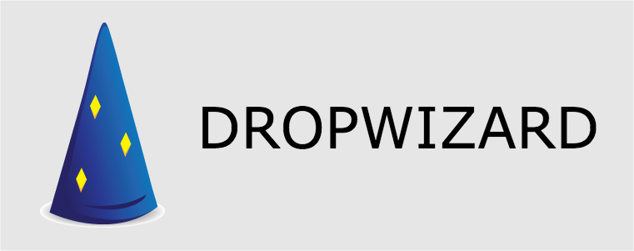

Slide 85
Dropwizard
Dropwizard is an open source Java framework used for the fast development of RESTful web services.
It's a light-weight best-in-class set of tools and frameworks for building RESTful web services.

Slide 86
Dropwizard
Its goal is to provide performant, reliable implementations of everything a production-ready web application needs.
Because this functionality is extracted into a reusable library, your application remains lean and focused, reducing both time-to-market and maintenance burdens.
Dropwizard allows a developer to build an initial project very fast - a so-called quick bootstrap project.
This helps the application to be packaged in a way that allows it to be easily installed on the production environment as a stand-alone service.

Slide 87
Default Dropwizard Components
Jetty HTTP library
Jersey
Jackson
Metrics: Dropwizard has its own library, that allows us to read the application metrics through HTTP endpoints.
Guava: is Google's utility library that gives us a large number of classes to speed up development in Java.
Logback and Slf4j: These two libraries are used for logging, similar to JDK logging (java.util.logging)

Slide 88
Default Dropwizard Components
Freemarker and Mustache: Choosing a template processor is one of the more important decisions.
Dropwizard uses well-known and popular and processors to create user interfaces.
Apache HttpClient: Provides the ability to interact with other web services.
Hibernate Validator: Used for validating user input.
Jdbi: Database access classes which have Hibernate support.
Joda time: Library for handling dates and time.
Liquidbase: Open source database-independent library for tracking, managing and applying database schema changes.

Slide 89
Mongo Connection
$ mongo
$ use donuts
> db.createUser({ user: "user_donuts", pwd: "pAsw0Rd", roles: [ { role: "readWrite", db: "donuts"} ]});
java -jar target/dropwizard-mongodb-ms-1.0.0-SNAPSHOT.jar server configuration.yml
http://localhost:7070/dropwizard-mongodb-ms/swagger

Slide 90
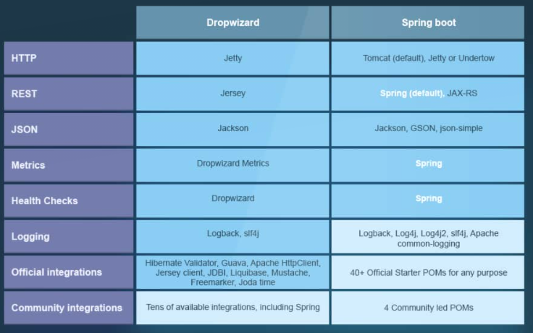
Drop wizard

Slide 91
Drop wizard
Libraries | Core: Jetty, Jersey, Jackson and Matrics Others: Guava, Liquibase and Joda Time. | Spring, JUnit, Logback, Guava. There are several starter POM files covering various use cases, which can be included in the POM to get started.
Concluding Remarks | If dealing with only REST micro services, drop wizard is an excellent choice. | Where Spring-boot shines is the types of services supported i.e. REST, JMS, Messaging, and Contract First Services. Not least a fully built in Dependency Injection container.

Slide 92
The Order Processing Application
The objective of the Order Processing Application is to process a customer order.
The order process functionality will generate the customer order, thereby making the order valid and approved.
A typical scenario will be a customer making an order request to buy a particular item.
The purchase department will receive the order request from the customer and prepare a formal purchase order.
The purchase order will hold the details of the customer, the name of the item to be purchased, the quantity, and the price.
Once the order is prepared, it will be sent to the Order Processing department for the necessary approval.
If the order is valid and approved, then the department will generate the unique order ID and send it back to the Purchase department.
The Purchase department will communicate the order ID back to the customer.

Slide 93
The Order Processing Application

Slide 94
CXF Framework
The Apache CXF framework helps us to develop web services using standard based programming model and also provides a flexible deployment model for deploying web services.

Slide 95
CXF Web Services Framework
Apache CXF provides robust support for several web service patterns and specifications:
JSR APIs: JAX-WS, JAX-RS, JSR-181 annotations, SAAJ
WS-* specifications for web service interoperability.
Rich support support for message transports, protocol bindings, content negotiation, data bindings, and so forth.
Flexible, lightweight deployment in a variety of web application containers or stand-alone.
Tooling for code generation
Tools for WSDL and WADL publishing.

Slide 96
CXF Components
*Bus
* Frontend
* Messaging and Interceptors
* Service Model
* Data bindings
* Protocol bindings
* Transport

Slide 97
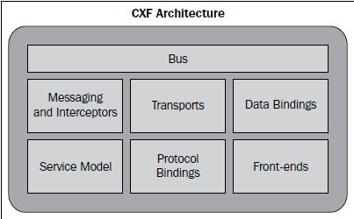
CXF Architecture

Slide 98
CXF Architecture
Bus is the backbone of the CXF architecture.
The CXF bus is comprised of a Spring-based configuration file, namely, cxf.xml which is loaded upon servlet initialization through SpringBusFactory.
It defines a common context for all the endpoints.
It wires all the runtime infrastructure components and provides a common application context.
The SpringBusFactory scans and loads the relevant configuration files in the META-INF/cxf directory placed in the classpath and accordingly builds the application context.

Slide 99
CXF Architecture
It builds the application context from the following files:
* META-INF/cxf/cxf.xml
* META-INF/cxf/cxf-extension.xml
* META-INF/cxf/cxf-property-editors.xml

Slide 100
CXF Architecture
<bean id="cxf" class="org.apache.cxf.bus.spring.SpringBusImpl">
<property name="outInterceptors">
<list>
<ref bean="myLoggingInterceptor"/>
</list>
</property>
</bean>
<bean id="myLogHandler" class="org.mycompany.com.cxf.logging.
LoggingInterceptor">
...
</bean>

Slide 101
CXF Architecture
Frontend
CXF provides the concept of frontend modeling, which lets usus create web services using different frontend APIs.
The APIs let us create a web service using simple factory beans and JAX-WS implementation.
It also lets us create dynamic web service clients.
The primary frontend supported by CXF is JAX-WS.

Slide 102
CXF Architecture
JAX-WS
JAX-WS is a specification that establishes the semantics to develop, publish, and consume web services.
JAX-WS simplifies web service development.
It defines Java-based APIs that ease the development and deployment of web services.
The specification supports WS-Basic Profile 1.1 that addresses web service interoperability.
It effectively means a web service can be invoked or consumed by a client written in any language.
JAX-WS also defines standards such as JAXB and SAAJ.
CXF provides support for complete JAX-WS stack.

Slide 103
CXF Architecture
JAXB provides data binding capabilities by providing a convenient way to map XML schema to a representation in Java code.
The JAXB shields the conversion of XML schema messages in SOAP messages to Java code without the developers seeing XML and SOAP parsing.
JAXB specification defines the binding between Java and XML Schema.
SAAJ provides a standard way of dealing with XML attachments contained in a SOAP message.

Slide 104
CXF Architecture
JAX-WS also speeds up web service development by providing a library of annotations to turn Plain Old Java classes into web services and specifies a detailed mapping from a service defined in WSDL to the Java classes that will implement that service.
Any complex types defined in WSDL are mapped into Java classes following the mapping defined by the JAXB specification.

Slide 105
CXF Architecture
Two approaches for web service development exist: Code-First and Contract-First. With JAX-WS, we can perform web service development using one of the said approaches, depending on the nature of the application.
With the Code-first approach, we start by developing a Java class and interface and annotating the same as a web service.
The approach is particularly useful where Java implementations are already available and we need to expose implementations as services.

Slide 106
CXF Architecture
Service Endpoint Interface (SEI) that defines the service methods and the implementation class that implements the SEI methods.
The consumer of a web service uses SEI to invoke the service functions.
The SEI directly corresponds to a wsdl:portType element.
The methods defined by SEI correspond to the wsdl:operation element.
@WebService
public interface OrderProcess {
String processOrder(Order order);
}
JAX-WS makes use of annotations to convert an SEI or a Java class to a web service.
In the above example, the @WebService annotation defined above the interface declaration signifies an interface as a web service interface or Service Endpoint Interface.

Slide 107
CXF Architecture
In the Contract-first approach, we start with the existing WSDL contract, and generate Java class to implement the service.
The advantage is that we are sure about what to expose as a service since we define the appropriate WSDL Contract-first.
Again the contract definitions can be made consistent with respect to data types so that it can be easily converted in Java objects without any portability issue.

Slide 108
CXF Architecture
WSDL contains different elements that can be directly mapped to a Java class that implements the service.
For example, the wsdl:portType element is directly mapped to SEI, type elements are mapped to Java class types through the use of Java Architecture of XML Binding (JAXB), and the wsdl:service element is mapped to a Java class that is used by a consumer to access the web service.
The WSDL2Java tool can be used to generate a web service from WSDL.
It has various options to generate SEI and the implementation web service class.
As a developer, we need to provide the method implementation for the generated class.
If the WSDL includes custom XML Schema types, then the same is converted into its equivalent Java class.

Slide 109
CXF Architecture
Simple frontend
Apart from JAX-WS frontend, CXF also supports what is known as 'simple frontend'.
The simple frontend provides simple components or Java classes that use reflection to build and publish web services.
It is simple because we do not use any annotation to create web services.
In JAX-WS, we have to annotate a Java class to denote it as a web service and use tools to convert between a Java object and WSDL.
The simple frontend uses factory components to create a service and the client.
It does so by using Java reflection API.

Slide 110
CXF Architecture
Simple frontend
The following code shows a web service created using simple frontend:
// Build and publish the service
OrderProcessImpl orderProcessImpl = new OrderProcessImpl();
ServerFactoryBean svrFactory = new ServerFactoryBean();
svrFactory.setServiceClass(OrderProcess.class);
svrFactory.setAddress("http://localhost:8080/OrderProcess");
svrFactory.setServiceBean(orderProcessImpl);
svrFactory.create();

Slide 111
CXF
CXF supports the following transports for its endpoints:
* HTTP
* CORBA
* JMS
* Local

Slide 112
Working with CXF Frontends
CXF supports the JAX-WS 2.0 API specification provided by Java Community Process (JCP).
JAX-WS is a formal specification by JCP that defines APIs to build, develop, and deploy web services.
CXF provides its own JAX-WS implementation adhering to JAX-WS specification standards.
The CXF JAX-WS frontend provides different APIs to build different kinds of web services.
Apart from providing standard WSDL-based development, it also provides APIs to build XML-based services in the form of Provider and Dispatch interfaces.

Slide 113
Working with CXF Frontends
CXF supports the JAX-WS 2.0 API specification provided by Java Community Process (JCP).
JAX-WS is a formal specification by JCP that defines APIs to build, develop, and deploy web services.
CXF provides its own JAX-WS implementation adhering to JAX-WS specification standards.
The CXF JAX-WS frontend provides different APIs to build different kinds of web services.
Apart from providing standard WSDL-based development, it also provides APIs to build XML-based services in the form of Provider and Dispatch interfaces.

Slide 114
Working with CXF Frontends
There are two ways or approaches for developing JAX-WS SOAP-based web services—Code-first development and contract-first development.
In Code-first development, as the name suggests, we start off with the code and then convert it into WSDL.
Code-first development is typically used where the input and output objects format of the implementation methods is simpler, and we want to quickly expose them as web services.
Code-first development is much simpler as we start off with Java objects without worrying about how the WSDL and XSD would be generated which could lead to issues where Java objects can't be mapped to XML elements the way we had intended.
Note that based on the input and output format of the implementation method, tools like CXF Java2WSDL would generate contracts, including XSD formats, for you.
For instance, we can't expose a Map or Collection as an output message format as there is no standard way to map this to an XML schema, and this could lead to interoperability issues.

Slide 115
Working with CXF Frontends
In Contract-first development the developer builds the web service from an existing WSDL artifact.
Contract-first development is typically used when we already have an XML schema defining the input and output message format for the web service operations, or we want to gain finer control of how the XML is being mapped to Java objects.
Contract-first development requires us to be well versed in XSD and WSDL contracts as you start modeling contracts using these constructs.
If we are creating services based on industry standards, we would probably start off with Contract-first development as the industry message formats are typically available as XML Schema.

Slide 116
Working with CXF Frontends
CXF supports both these approaches and provides support for various Data binding mechanisms which help you to map Java objects to XML.

Slide 117
Code-first development
Creating Service Endpoint Interface (SEI)
Adding Java annotations
Publishing the service
Developing a consumer
• Running the Code-first example

Slide 118
Creating Service Endpoint Interface (SEI)
Service Endpoint Interface is a Java interface that defines a business method to be exposed as a service method.
The service method is implemented by a service class.
An SEI can be modeled by using two different approaches:
Building an SEI component from scratch
Converting existing business functionality into service-based components

Slide 119
Creating Service Endpoint Interface (SEI)
The first approach is to build an SEI component from scratch, that is, develop a whole new web service without any existing code or WSDL contract.
It is recommended that we start by writing the service interface and then creating the service implementation class.
Writing the service interface is always good practice as it gives a proper client side view of us service methods.
The implementation class can then implement the methods defined in the interface.

Slide 120
Creating Service Endpoint Interface (SEI)
The second approach is to take the existing business functionality and convert it into service-based components.
Most of the time you have business logic already developed and you want to expose them as service methods.
You can achieve this by developing an SEI and defining only those business methods that you want to expose as a service method, and then make the existing Java code implement that SEI.
The other approach commonly used is to create Wrapper SEI and an implementation class, which would use the existing implementation classes to carry out the functionality.

Slide 121
Creating Service Endpoint Interface (SEI)
We start by developing an OrderProcess SEI and implementing it. The following code illustrates the
OrderProcess SEI:
package demo.order;
public interface OrderProcess {
String processOrder(Order order);
}
The above code, as you can see, is a simple POJO interface. It defines one abstract method processOrder that takes an Order bean as a parameter.
The OrderProcessImpl implementation class implements the processOrder method, and this method will be exposed later as a web service method.

Slide 122
Creating Service Endpoint Interface (SEI)
You will write the OrderProcessImpl class that will implement the OrderProcess SEI.
The following code illustrates the OrderProcessImpl class:
package demo.order;
public class OrderProcessImpl implements OrderProcess {
public String processOrder(Order order) {
System.out.println("Processing order...");
String orderID = validate(order);
return orderID;
}
. . .

Slide 123
Creating Service Endpoint Interface (SEI)
The above code is a simple POJO implementation class that implements the processOrder method.
The method simply verifies the order and returns a unique order ID. For simplicity, we return a static order ID as part of our implementation.

Slide 124
Adding Java annotations
javax.jws.WebService
A Java component can be converted into a service by adding a @WebService annotation.
This annotation has to be defined both in SEI and the implementation class.
The @WebService annotation is defined by the javax.jws.WebService interface.

Slide 125
Adding Java annotations

Slide 126
Adding Java annotations

Slide 127
Adding Java annotations

Slide 128
Adding Java annotations
javax.jws.soap.SOAPBinding
The @SOAPBinding annotation is defined by the javax.jws.soap.SOAPBinding interface.
The annotation is used if we want to specify SOAP binding for our service.

Slide 129
Adding Java annotations

Slide 130
RPC versus Document style
The web service SOAP communication style plays an important role in communicating SOAP XML messages between service provider and consumer.
There are two SOAP message styles, Document and RPC.
The SOAP message styles are defined in WSDL document as SOAP binding.
A SOAP binding can have an encoded use or a literal use.
Encoding, as the term implies the message would be encoded using some format, while literal specifies plain text messages without any encoding logic.
Document style, as the name suggests, deals with XML documents as payloads which adhere to well defined contracts, typically created using XML Schema definitions.
The XML schema format specifies the contract of the service messages invoked by consumers.
The XML Schema defines the request and response message format between service provider and service consumer which can be validated by service consumer or service provider.
Document literal style is the preferred way for web service communication to achieve interoperability.

Slide 131
RPC Style
RPC (Remote Procedure Call) style, on the other hand, indicates that the SOAP body contains an XML representation of a method.
In order to serialize method parameters into the SOAP message so that it can be deserialized back by any web service implementation, the SOAP specification defines a standard set of encoding rules.
As RPC is traditionally used in conjunction with the SOAP encoding rules, the combination is referred to as RPC/encoded.
We also have an RPC/literal communication style model where we don't have any encoding formats, but still the messages are limited to RPC method-based communication, where messages can't be validated as they are not tied to any XML schema definition.
We should probably avoid developing RPC style web services as they have a lot of interoperability issues.

Slide 132
RPC Style
The following code illustrates the use of the @SOAPBinding annotation:
@WebService(name="OrderProcess")
@SOAPBinding(parameterSyle=ParameterStyle.BARE)
public interface OrderProcess {
String processOrder(Order order);
}

Slide 133
javax.jws.WebMethod
The @WebMethod annotation is defined by the javax.jws.WebMethod interface.
The annotation is used for customizing web service operation.
The @WebMethod provides the operation name and action attributes which are used to customize the name attribute of the <wsdl:operation> element and the soapAction attribute of the <soap:operation> element in the WSDL document.
The @WebMethod annotation is placed just above the service method declaration.

Slide 134
javax.jws.WebMethod

Slide 135
Publishing the service
Publishing the service means registering the service component on the server and making it available to the consumer through the endpoint URL.
We will publish the OrderProcess web service on a particular endpoint URL.
The endpoint URL in this case will be http://localhost:8080/OrderProcess.
we will develop a server component that will publish your OrderProcess service.

Slide 136
Publishing the service

Slide 137
Developing a consumer
The consumer of the web service invokes the service method to get the required result.
In this section we will develop a Client class that will look up our OrderProcess service and invoke its processOrder method.

Slide 138
Developing a consumer

Slide 139
Apache Play
Play is a high-productivity Java and Scala web application framework that integrates components and APIs for modern web application development.
Play was developed by web developers for web application development.
You will find Play’s Model-View-Controller (MVC) architecture familiar and easy to learn.
Play provides concise and functional programming patterns.
The large community developing Play applications provides an excellent resource for getting your questions answered.

Slide 140
Apache Play
As a full-stack framework, Play includes all the components to build Web Applications and REST services.
It has an integrated HTTP server, form handling, Cross-Site Request Forgery (CSRF) protection, a powerful routing mechanism, I18n support, and more.
Play saves precious development time by directly supporting everyday tasks and hot reloading so that you can immediately view the results of your work.

Slide 141
Apache Play
Play’s lightweight, stateless, web-friendly architecture uses Akka and Akka Streams under the covers to provide predictable and minimal resource consumption (CPU, memory, threads).
Play is non-opinionated about database access, and integrates with many object relational mapping (ORM) layers.
It supports Anorm, Slick, and JPA out of the box, but many customers use NoSQL or other ORMs.

Slide 142
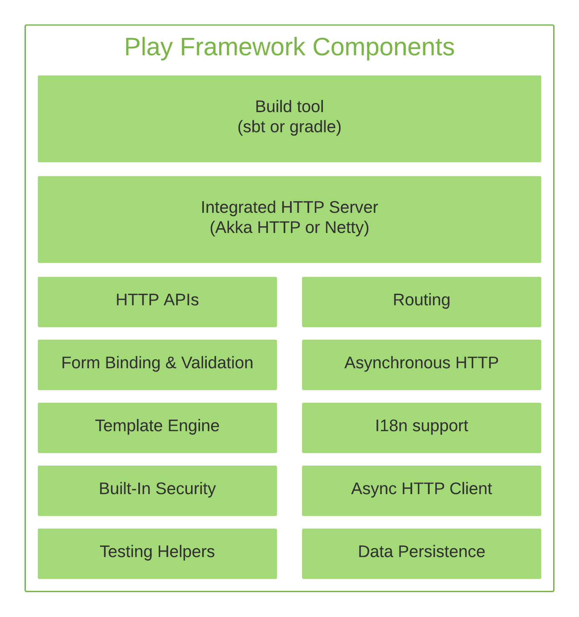

Slide 143
Conclusion
JAX-RS is a flexible API for providing scalable web services.
CXF, Spring and the Java Stack integrate to make developing and configuring REST services easy.
Many aspects of the request, response, and exception handling can be customized through use of MessageBodyReader, MessageBodyWriter, ResponseBuilder, and ExceptionMapper.

Slide 144
Questions

Slide 145
Module Summary
Spring Integration Framework.
Message, Channel and Adapter
Understood the different Component Integration
Understood the Event-Driven Architecture

